Slide 1

LIBRARY MANAGEMENT System
PRESENTED BY :-
Name - Kalpana Behera
Batch No. - 8271
Course Name - Post Graduate Certification in Java Full Stack Development for Engineers

Slide 2
INTRODUCTION
Full Stack Application – Library Management System(Library).
A library management system is an application that is designed to manage all the functions of a library. It helps librarians to maintain the database of new books and the books that are borrowed by members. This system completely automates all your library's activities.
The basic functions of library management include overseeing all library operations and managing data.

Slide 3
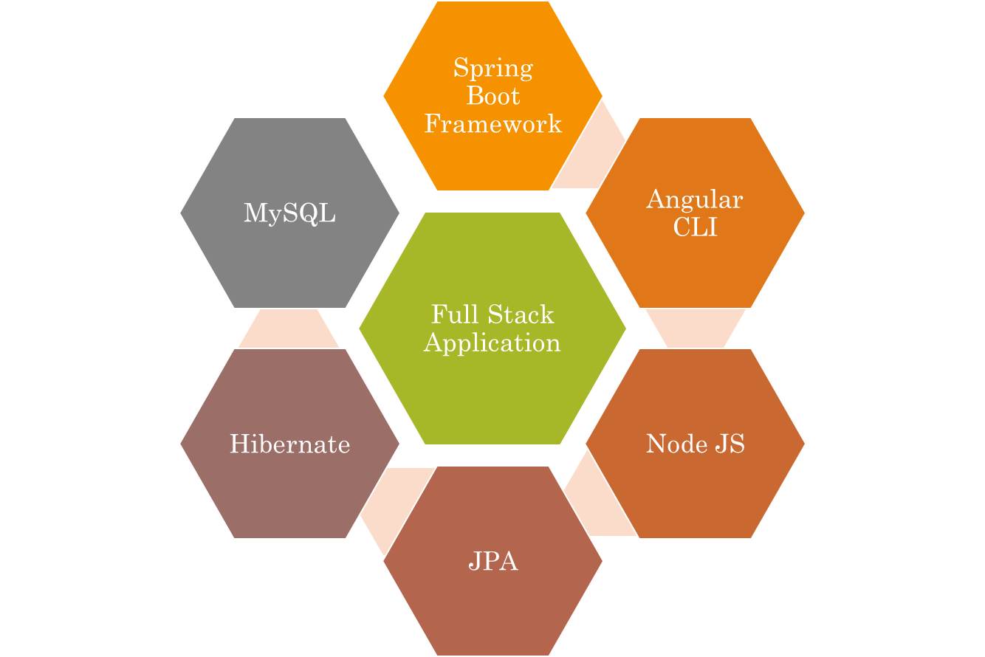
Technologies Used

Slide 4
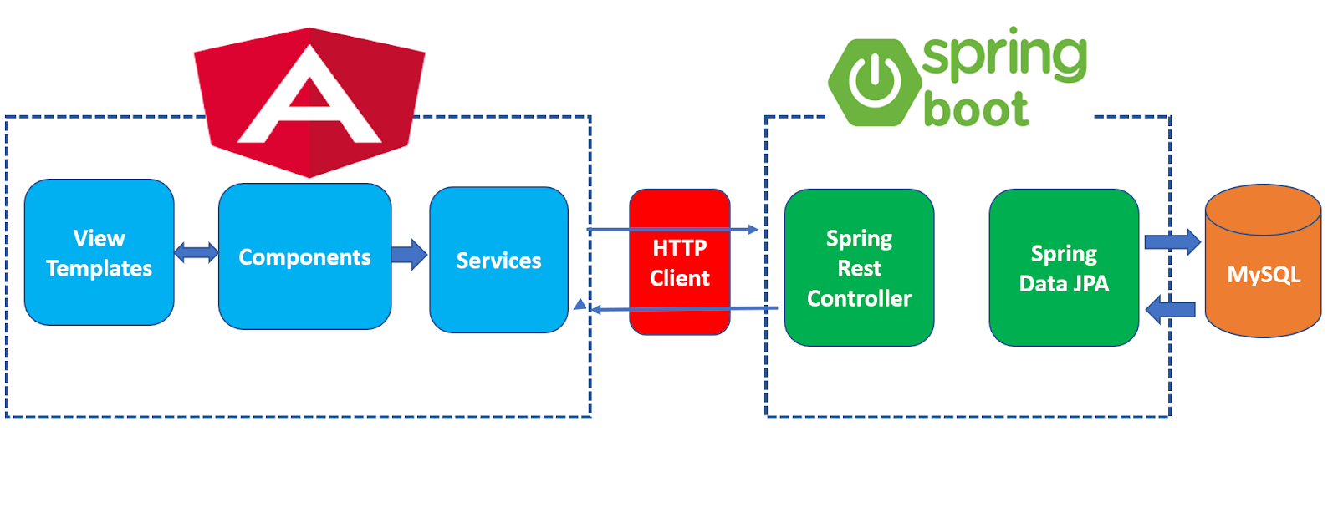
THE ARCHITECTURE OF ANGULAR, SPRING Boot & MySQL(DATABASE)

Slide 5
The Architecture of the project
Angular JS
Node JS
Frontend
Spring Boot
Backend
MySQL

Slide 6
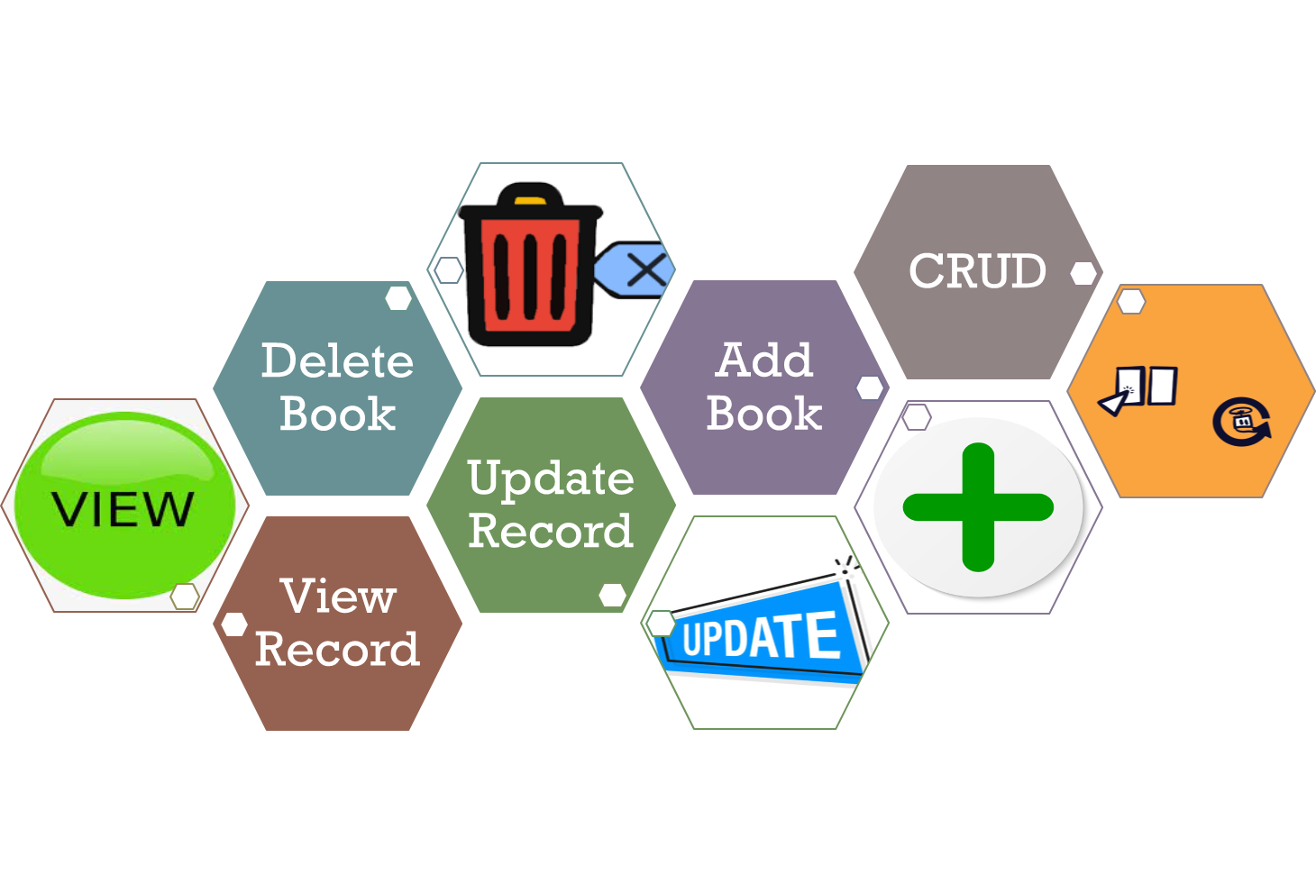
CRUD OPERATIONS

Slide 7
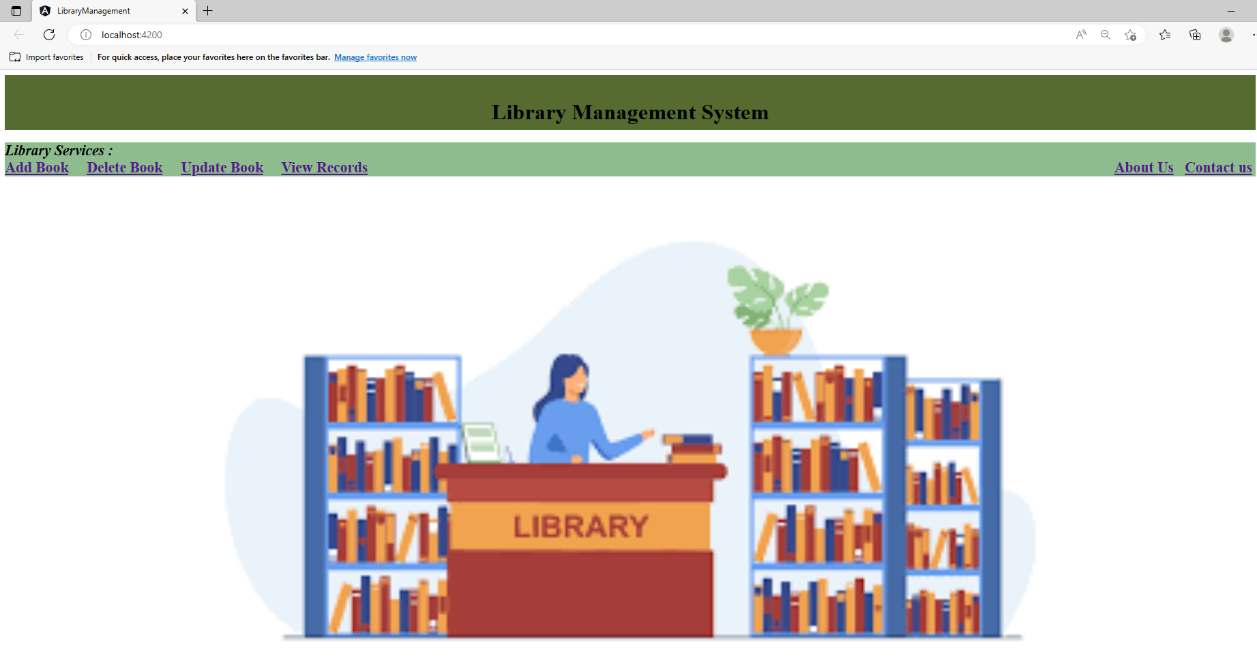
HOME PAGE

Slide 8
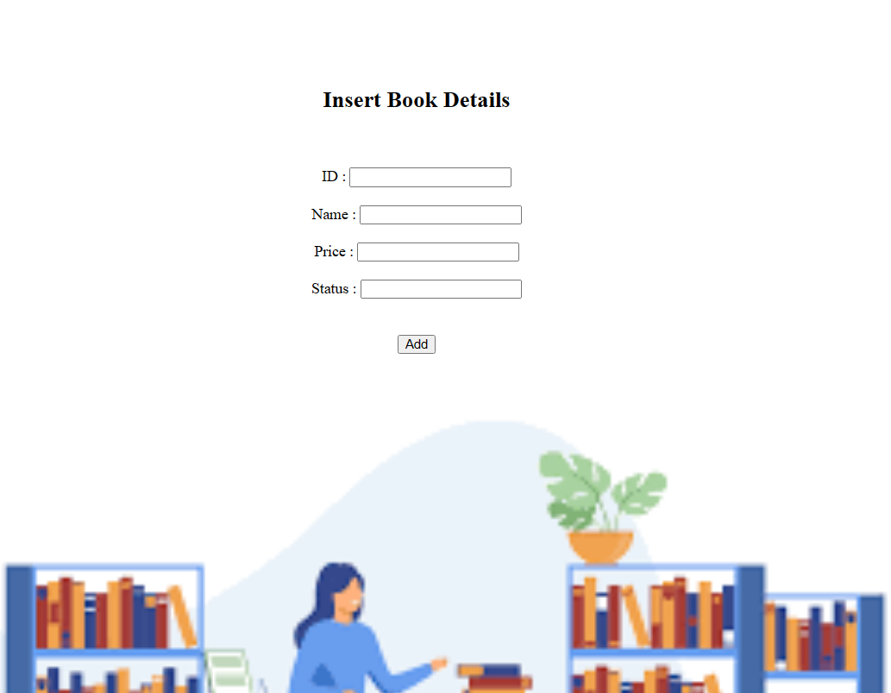
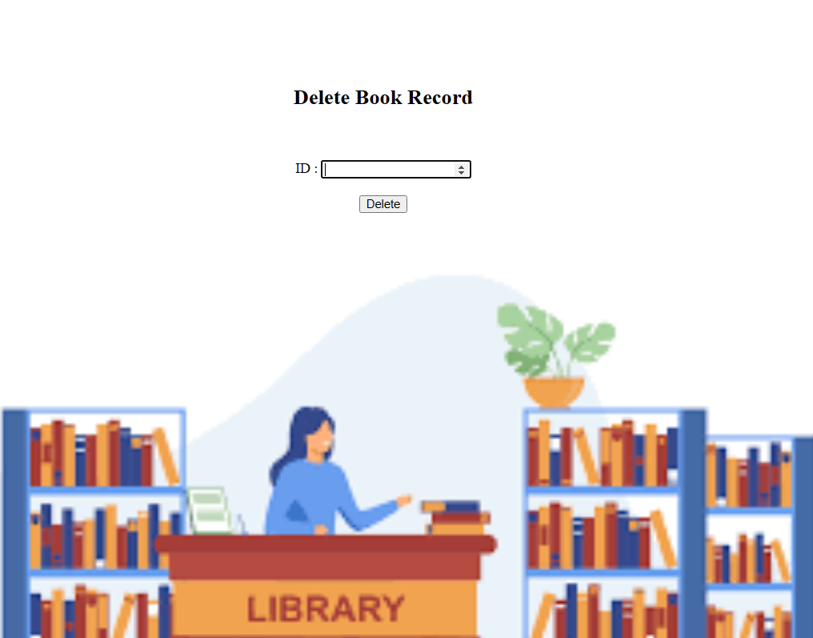
LIBRARY SERVICES
Add & Delete Page

Slide 9
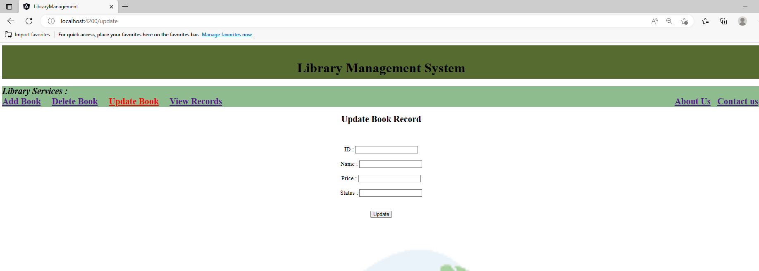
Update Page

Slide 10
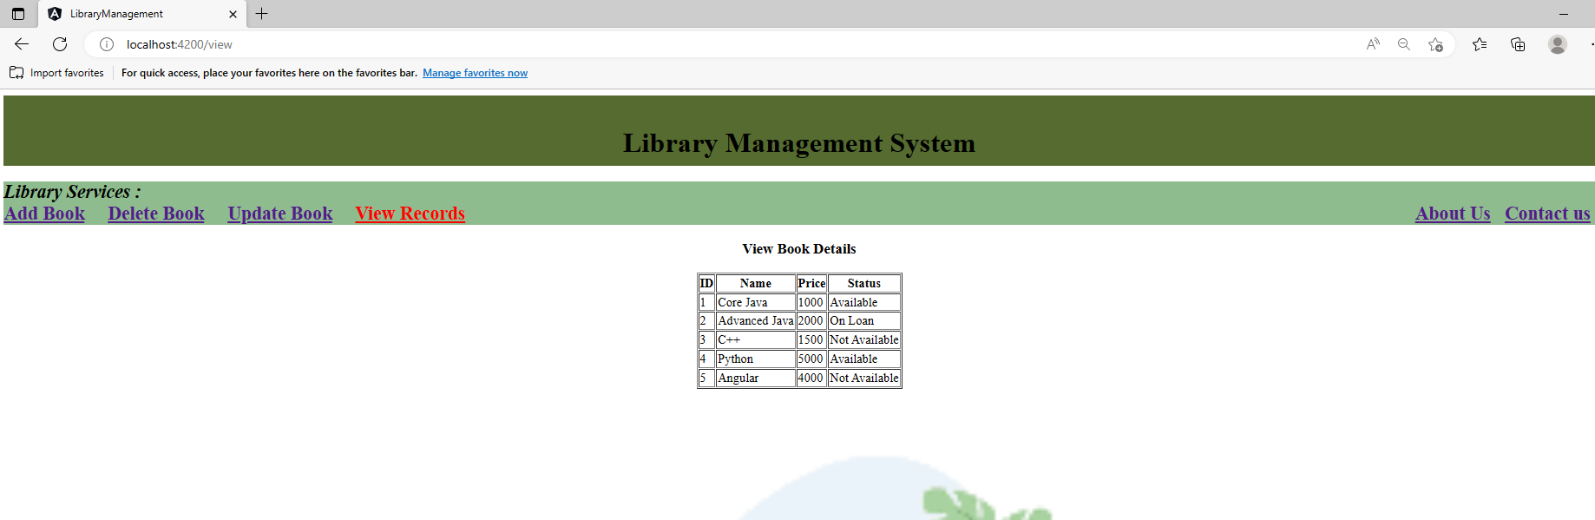
View Record

Slide 11
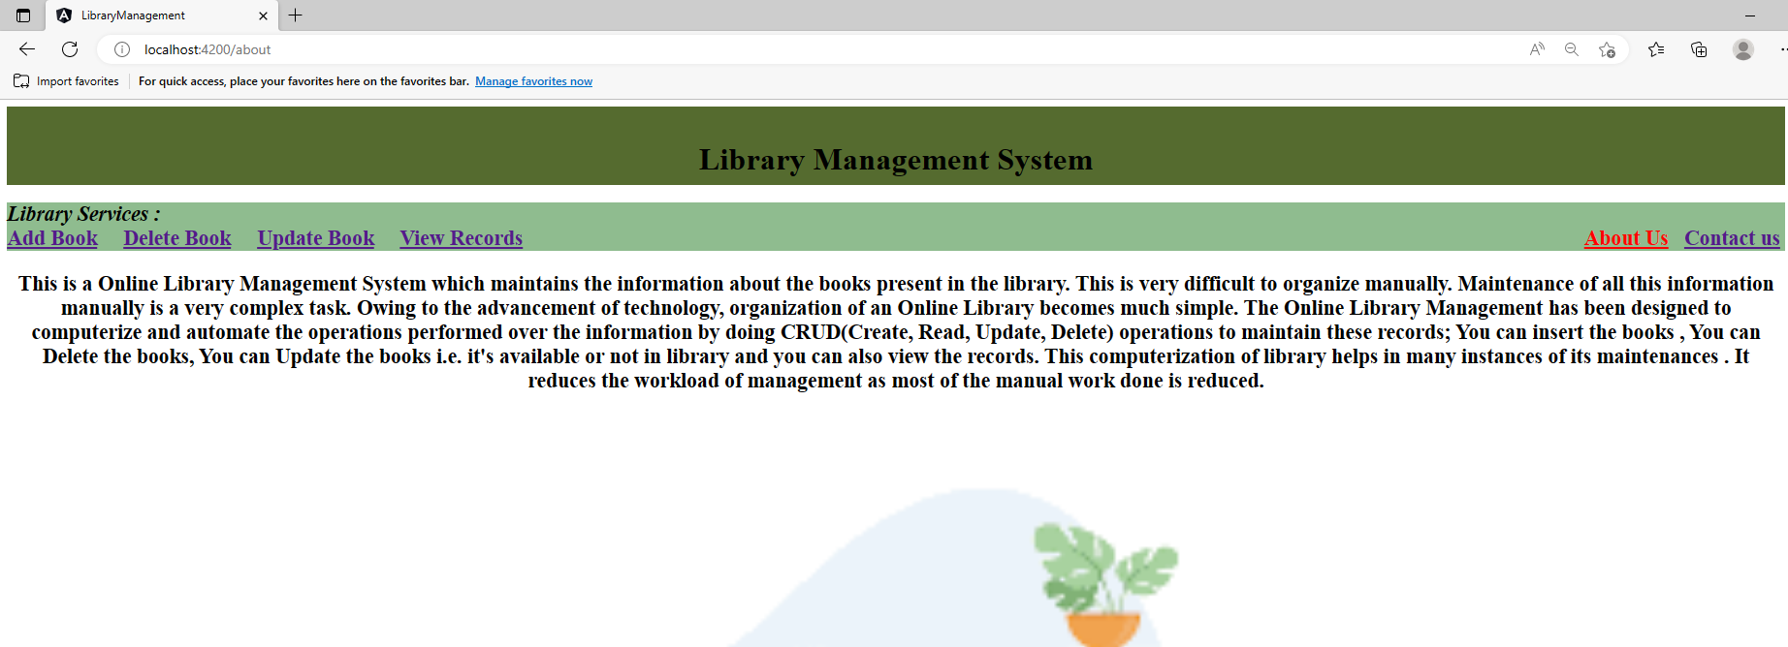
About us PAGE

Slide 12
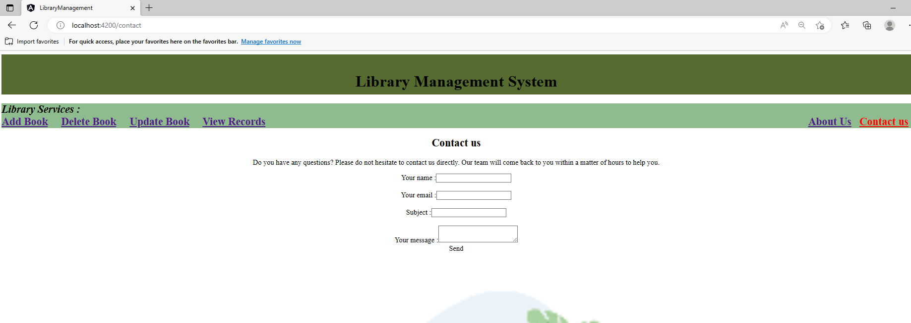
Contact us Page

Slide 13
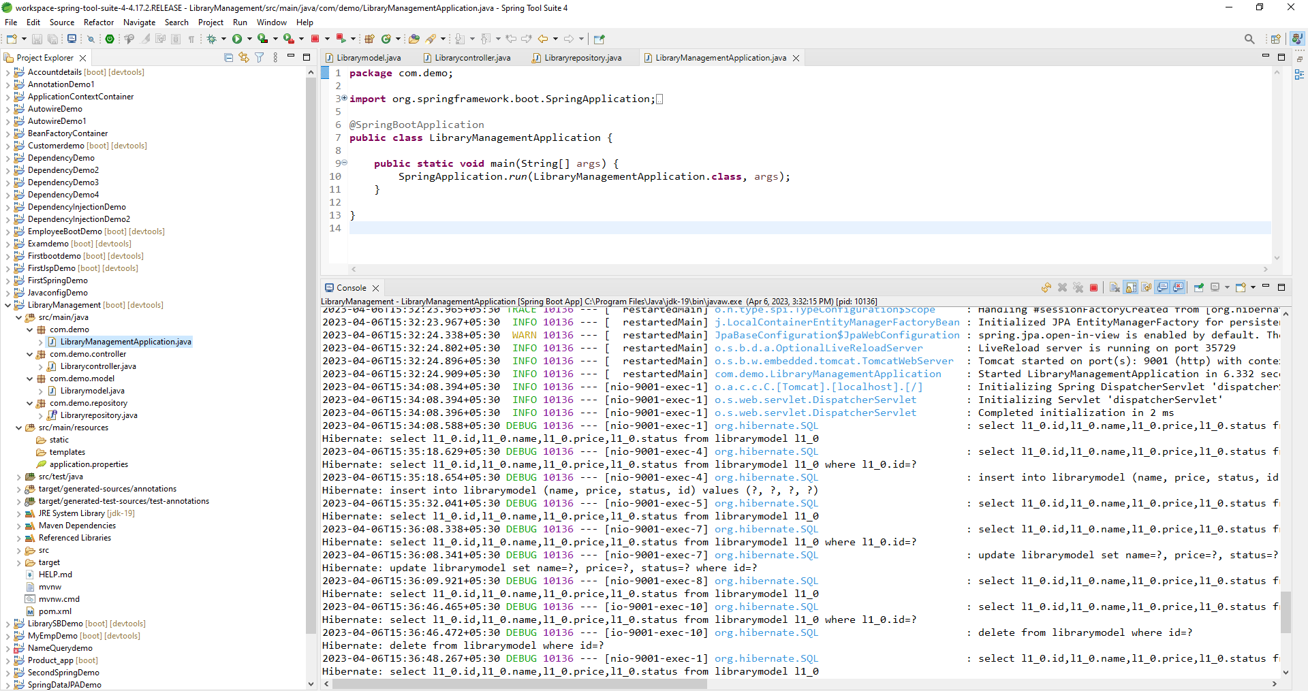
Spring Boot Application

Slide 14
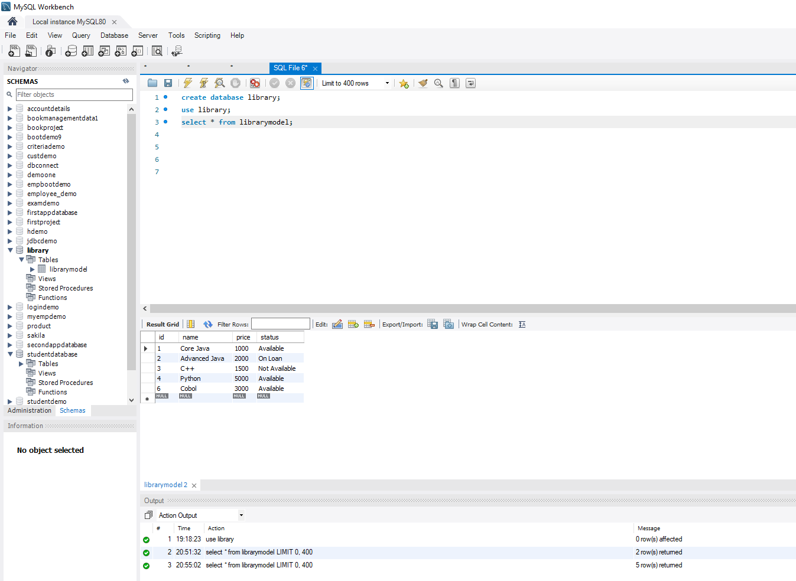
MySQL Code

Slide 15
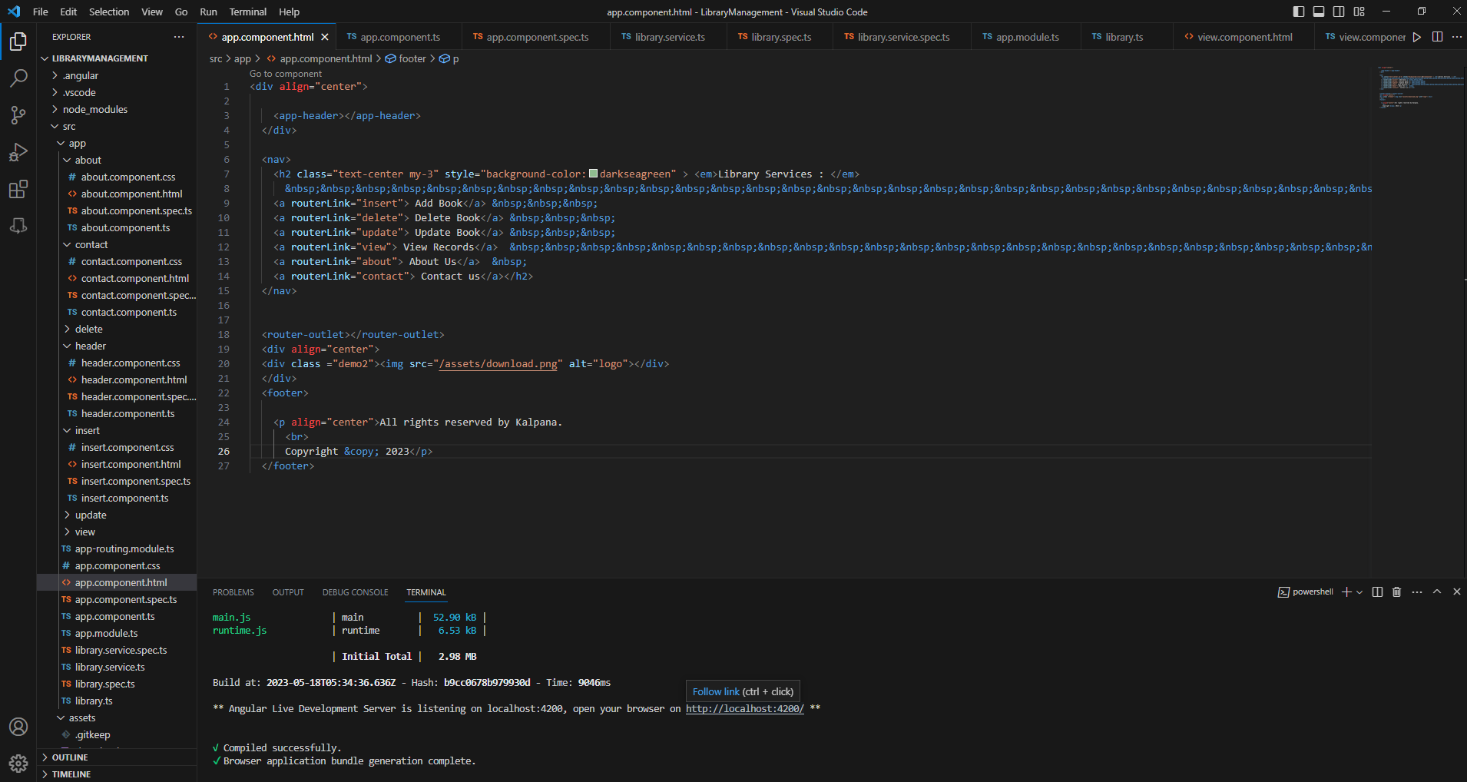
Frontend-Angular js

Slide 16
Future enhancements
The scope of this project is as follows:
To assist the staff in capturing the effort spent on their respective working areas.
To utilize resources in an efficient manner by increasing their productivity through automation.
The system generates types of information that can be used for various purposes.

Slide 17

GitHub Link
https://github.com/kalpanabehera45/Library-Management-System.git

Slide 18

Thank You

